Slide 1
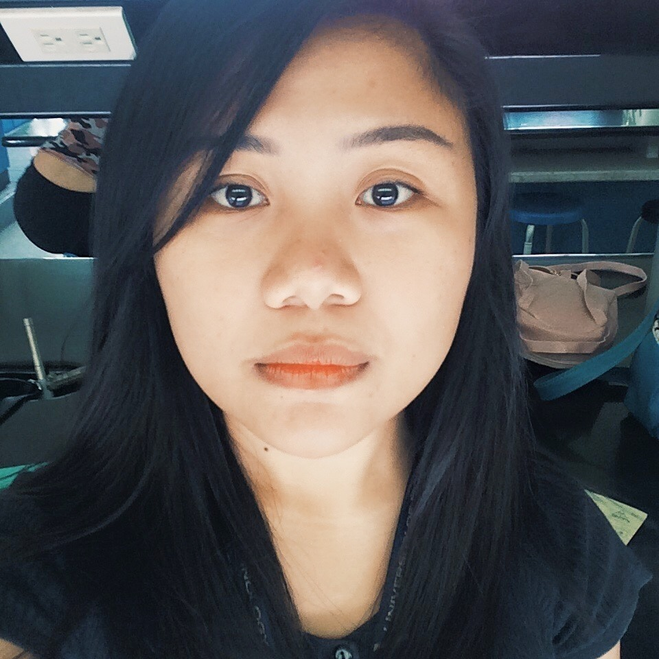

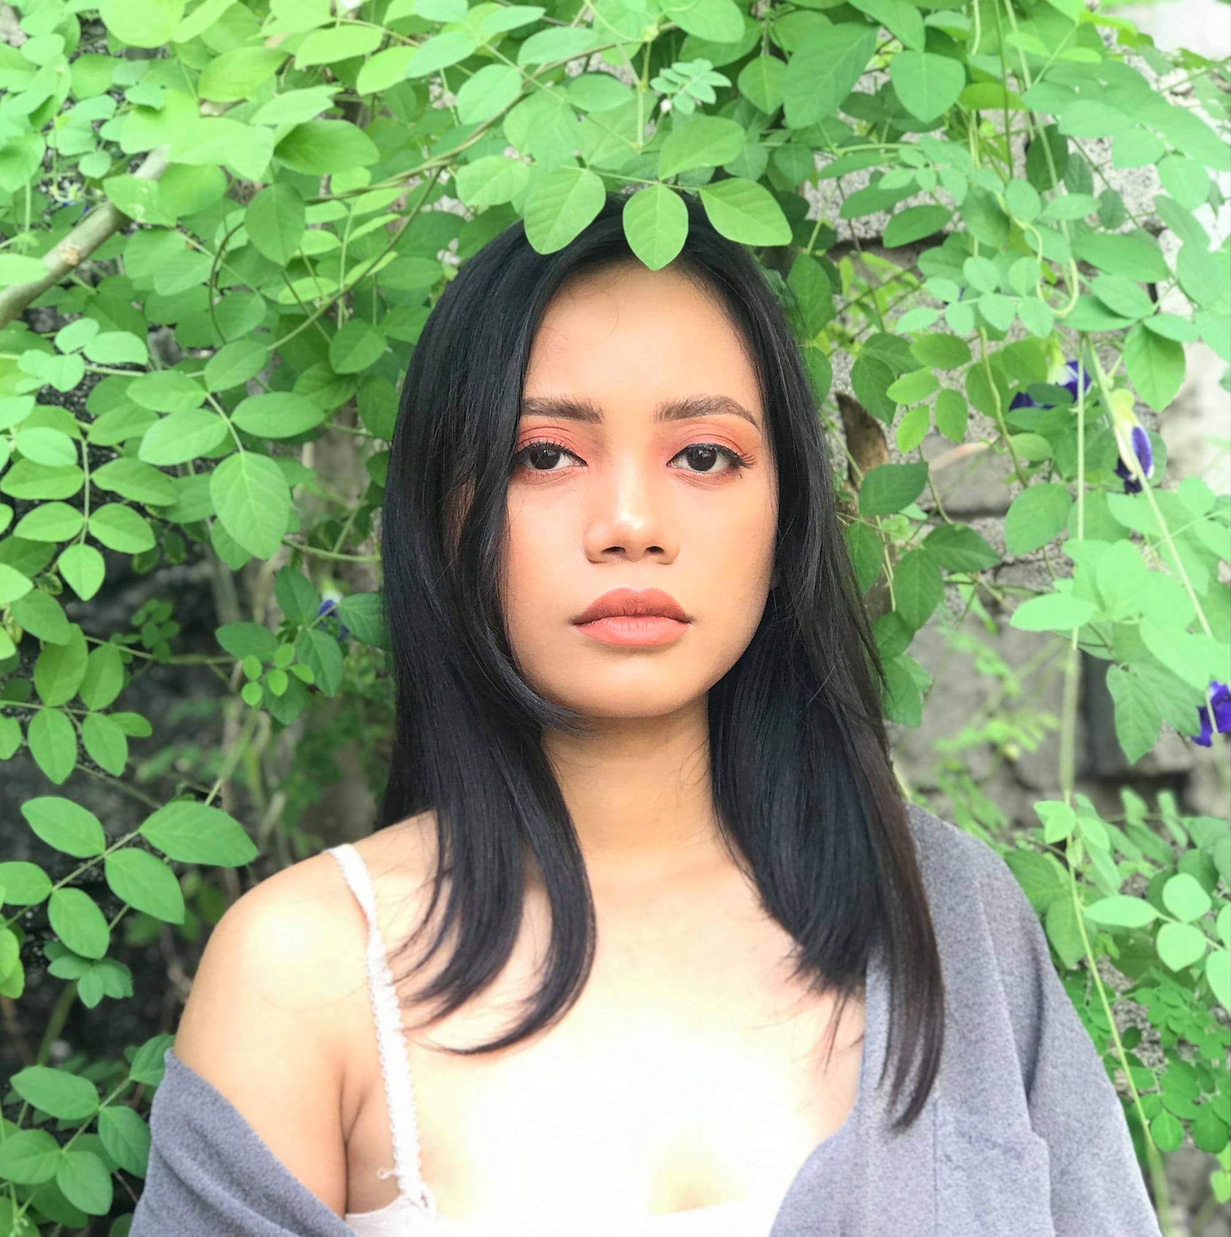
Hi-Prof Kiosk :
An IoT-Based Appointment Queuing Kiosk System
Cymel Ann Jabay
Jinomel Fajardo
Shiela Mae Golosino

Slide 2
Technical Panel 1: Archie Pachica
- Network achitecture diagram
- System Architecture
- Add nameplate before LED
- Add button on name plate
- Where is the complexity in your study?
- Remove camera
Charman : Petal May Dal
- Objectives: diffrence between design, develop and create
- What to do with the data?
- Why do we need to decongest?
- Database diagram
- Survey
- Remove camera
General Comments :
- Workout what really the problem is.
- Current technology to compare with the study.
- Objectives anchored on the statement of the problem.
- Importance of consultation hours.
- Simple web interface.
- Instructor registration
- Faculty input their consultation schedule.
- When is the faculty available.
- Queuing
- General inquiry and specific inquiry.
- Reports catered consultations can be used for accreditation or
audit that can undergone in school
- Never mind the camera

Slide 3
Technical Panel 1: Baldelovar
- Statement of the problem should coinside with the objectives.
- Creating limitation should be in other pharagraph.
- Adding Department that can benifit.
- Add activity diagram.
- Add study diagram.
- Know the author of data flow diagram
- Follow the rules how to creat diagram
- All the table in ERD should be seen in DFD.
- Know the OS to be used in server.
- Specify the software and hardware recomendation.
- Specify the local server.
Charman : Jesse
- Chairman is treated as instructor.
- Fucos what is needed to the project.
- Remove the camera.
- Look for another agile diagram that you can explain.
- Explain your diagram well.
- Who would extract the date?
- There should be Admin to do the manage the system.

Slide 4
Technical Panel 3: Dal
- Remove camera
- Add static picture (floor plan of the office).
- Purpose is redundant.
- The relationship should be one to many consultation.
- Date and time is critical.
- Emphasize the problem generally .
- student come anytime regardless consultation or not.
- minimized the kanus-a mo abot si instructor.
- Revised the objectives.
- design -> develop -> evaluate
- Revised context diagram.
General comments:
- Add Status and remarks.
- Can be used for Sol Accord.
- Action taken.
- Resolved or pending.
- Take note all the panel comments and suggestions.
- Put admin, but no need to specify the chairman as admin.
- Correct the documents.

Slide 5
BACKGROUND OF THE STUDY
Siming et al. (2015) stated that campus services and facilities are radically related to student satisfaction. Therefore, services provided for the students to support campus life are beneficial to contribute to student satisfaction, hence to academic success.
Each time a student tries to consult their IT instructors at their office about subject matter, grades, project and activities it mostly ends up with them knocking at the office door, asking the closest person inside to know if their instructor is present and the student is likely to look around in the room hoping to see if their instructor is in sight.
The Hi-Prof Kiosk also serves as a modernized visitor records for the IT Department Office. Greetly Digital Receptionist (2021) discusses the 3 benefits of keeping visitor records which are:
- Security
- Emergency Preparedness
- Analytics

Slide 6
BACKGROUND OF THE STUDY
The study focuses on designing an interactive IoT-based appointment queuing kiosk for the IT Department Office that manages the consultation process. The students can access the queuing process to make request for consultation to the chairman or to their instructor and instructor can use the web application to have an efficient way to control and organize of calling or declining the student.

Slide 7
STATEMENT OF THE PROBLEM
It disturbs other instructors and makes the room crowded with the number of students inquiring inside the office.
The absence of modern inquiry system which can affect the focus of the instructor working inside.
The health of the instructors and the students is also at risk.
The security of the faculty working inside the IT department office.

Slide 8
OBJECTIVES
3. To design and develop an interactive IoT-based appointment queuing kiosk for which students can access to make request for specific consultation to specific faculty or to the department chairman.
1.To gather data and analyze requirements necessary for system design.
2.To help reduce disturbances caused by student’s unnecessarily entering and leaving the office.
4.To design and develop a simple web application system for faculty to monitor and manage the student’s consultation, update their personal information and set their consultation schedule.

Slide 9
SCOPE AND LIMITATION
This study mainly focused on designing and developing a touchscreen kiosk system for students wishing to inquire to see a faculty and the department chairman, particularly the IT Department Office (4th floor). The study aims to address the current problem of students looking for their instructor and the department chairman face-to-face inside the IT Department Office. Hence, the study is exclusive only to the selected department office in the University of Science and Technology of Southern Philippines (USTP). This research is limited to other problems or topics that fall outside of the scope of the study. The study's development and implementation will be solely in the above-said school area.

Slide 10
SIGNIFICANCE OF THE STUDY
Students
Precisely they will be able to know if the instructor or chairman is available or unavailable. This study will also serve as reference for students undertaking similar studies.
Faculty
This will help the faculty to control the student crowd coming inside the department office and will allow them to post if they’re available or unavailable. Implementing an organized process of inquiring to see a faculty or the department chairman inside the department office. Provision of actual consultation log for administration and accreditation purposes.
Future Researcher
The outcome of this research will be a useful reference for the researchers who would plan to make the same or related study, especially students undertaking the Bachelor of Science in Information Technology.

Slide 11
REVIEW OF RELATED LITERATURE

Slide 12
TITLE | CAMERA | USER ACCESS | IOT-BASED | INTERACTIVE | APPOINTMENT MODULE | CONSULTATION MODULE | SETUP CALENDAR | REFERENCE
Innovative framework for self-service kiosks: Integrating customer value knowledge |  | ✔ |  | ✔ |  | ✔ | ✔ | https://www.elsevier.es/en-revista-journal-innovation-knowledge-376-articulo-innovative-framework-for-self-service-kiosks-S2444569X19300393
Developing KIOSKs - Touch Based Interactive Information System |  | ✔ |  | ✔ | ✔ | ✔ | ✔ | https://www.researchgate.net/publication/321527782_Developing_KIOSKs-Touch_Based_Interactive_Information_System
UXD for a Prototype Campus Information Kiosk |  | ✔ |  | ✔ |  |  |  | https://www.scitepress.org/Papers/2018/72298/72298.pdf
TECHNOLOGY-BASED SELF-SERVICE KIOSKS IN RETAILING: AN OPTIONAL CHANNEL FOR CUSTOMER SERVICE |  | ✔ |  | ✔ |  |  |  | https://www.researchgate.net/publication/330924708
Online Appointment Management System |  | ✔ |  | ✔ | ✔ | ✔ | ✔ | https://www.researchgate.net/publication/266171377_Online_Appointment_Management_System
HOSPITAL APPOINTMENT SYSTEM |  | ✔ | ✔ | ✔ | ✔ |  | ✔ | https://www.irjmets.com/uploadedfiles/paper//issue_7_july_2022/28245/final/fin_irjmets1657918796.pdf
Hi Prof Kiosk: An IoT-based Appointment Queuing Management Kiosk | ✔ | ✔ | ✔ | ✔ | ✔ | ✔

Slide 13
SYNTHESIS OF REVIEW RELATED LITERATURE
Kiosk now a days are increasingly being used and establishments can display useful information by using these kinds of devices. There is virtually no area where information kiosks can’t be used for a better customer satisfaction and cutting costs. It is being used by more and more educational institutions these days, for instance, providing access to information on the different programs, course outline, helpful student information, and registration for course, payment of fees and various other purposes. Kiosks have become an essential part in of daily lives today such as processes and transactions. Some of which are used for Information Systems, Or Food Ordering Kiosks, or even for Queuing number system. These kind of System ideas makes the human daily lives easier and more convenient at the same time.

Slide 14
METHODOLOGY
This is where you section ends. Duplicate this set of slides as many times you need to go over all your sections.

Slide 15
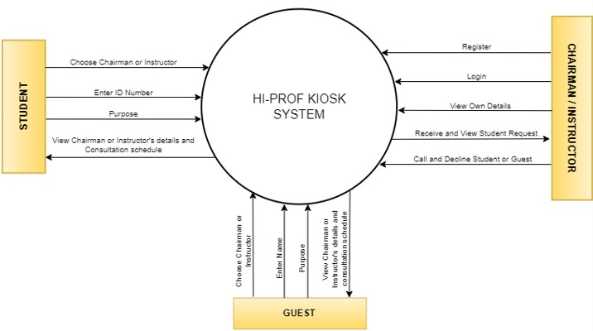
CONTEXT DIAGRAM

Slide 16
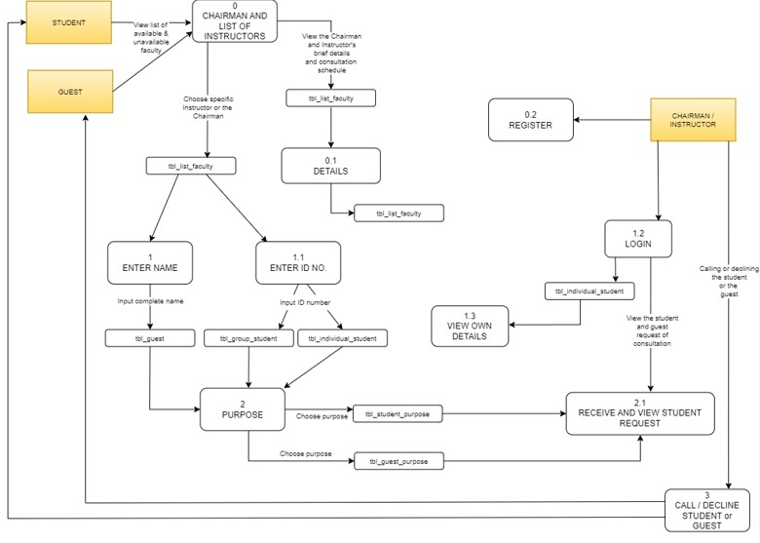
DATA FLOW DIAGRAM

Slide 17
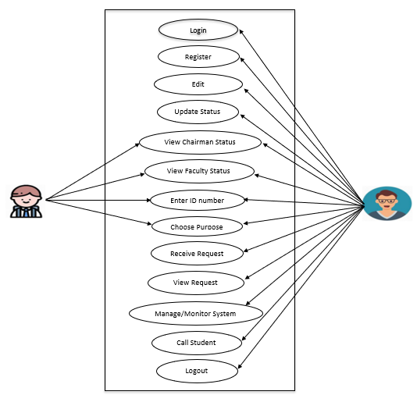
USE CASE DIAGRAM
STUDENT
FACULTY

Slide 18
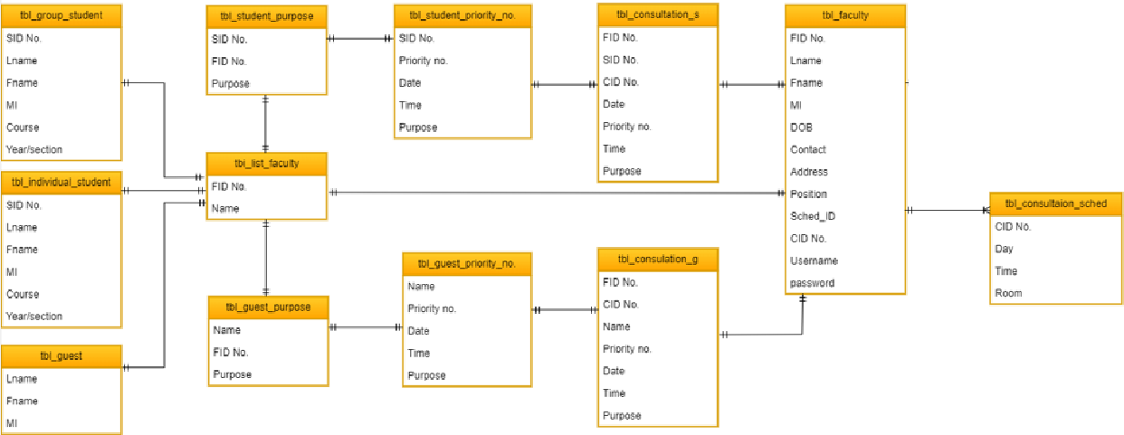
ENTITY RELATIONSHIP DIAGRAM

Slide 19
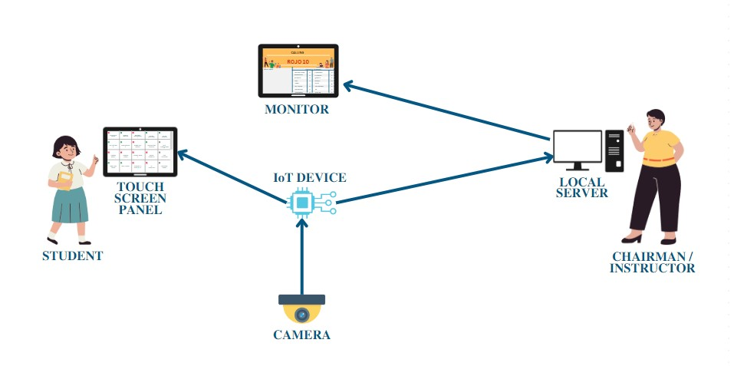
SYSTEM ARCHITECTURE

Slide 20
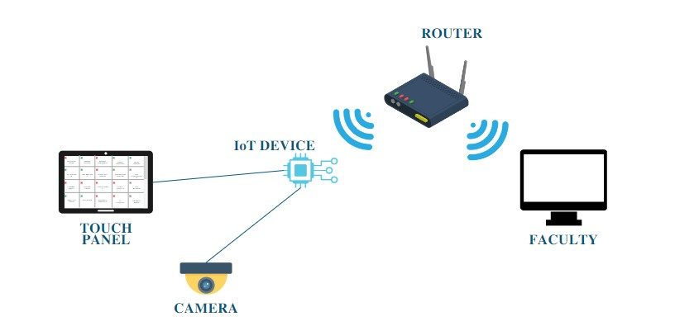
NETWORK ARCHITECTURE DIGRAM

Slide 21
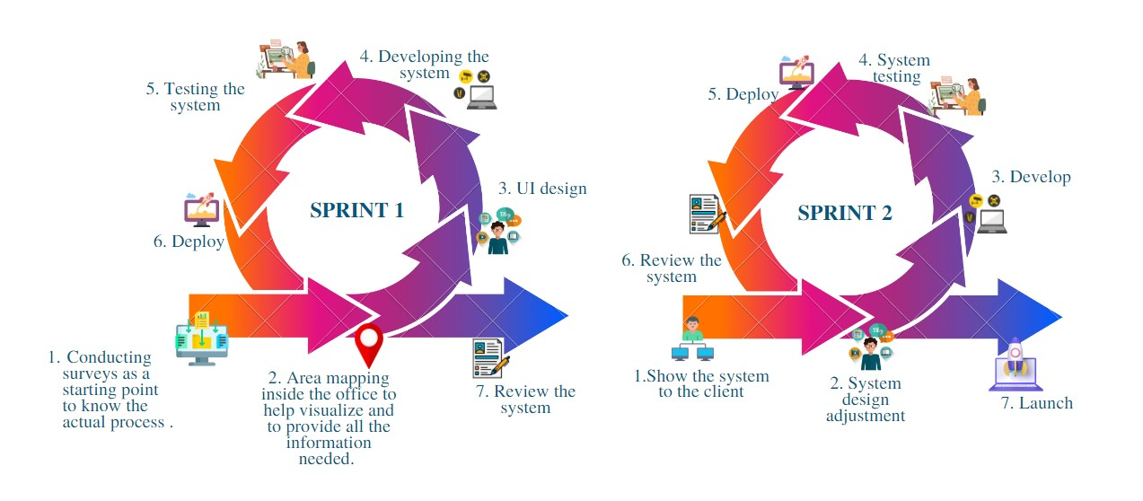
NETWORK ARCHITECTURE DIGRAM

Slide 22
WIRE FRAMES
TOUCH PANEL
WEB INTERFACE
MONITOR

Slide 23
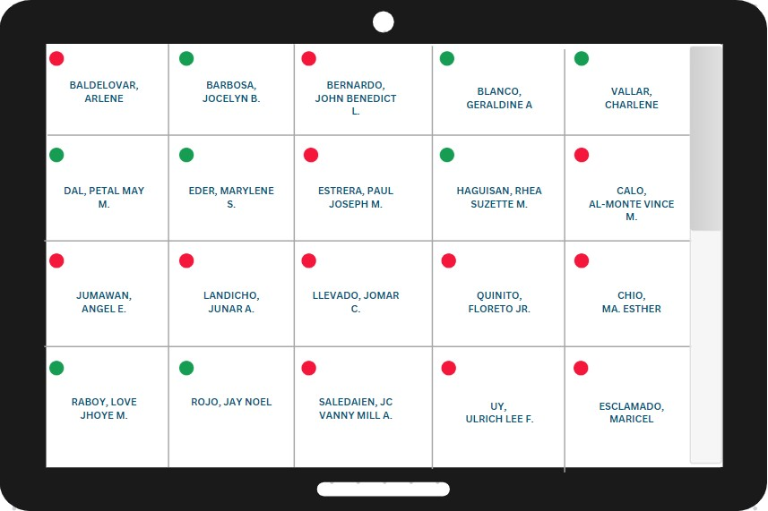
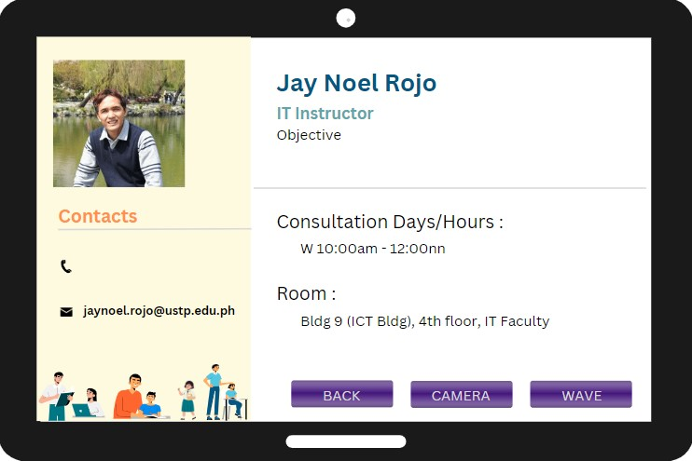
TOUCH PANEL

Slide 24
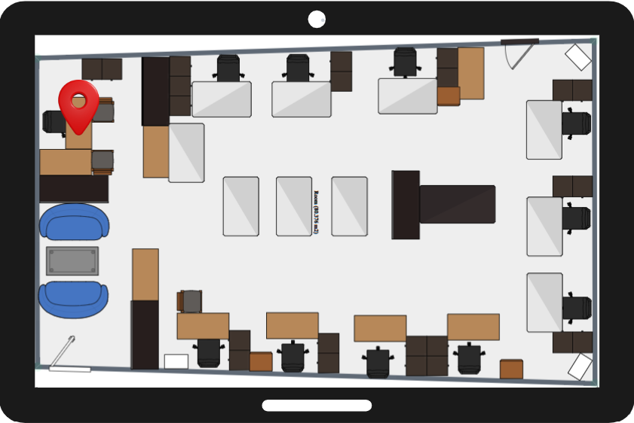
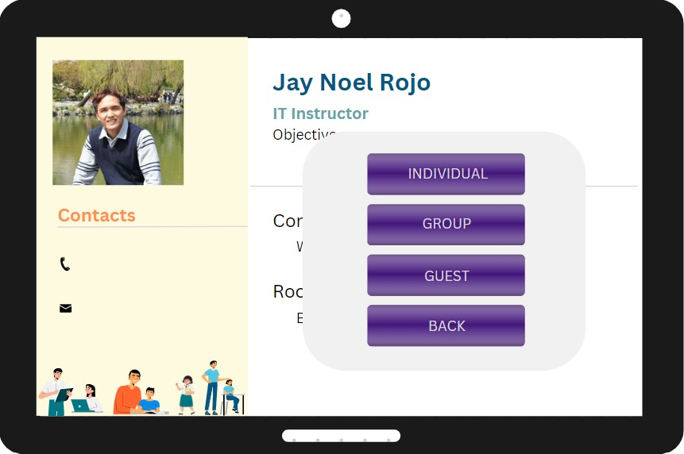
TOUCH PANEL

Slide 25
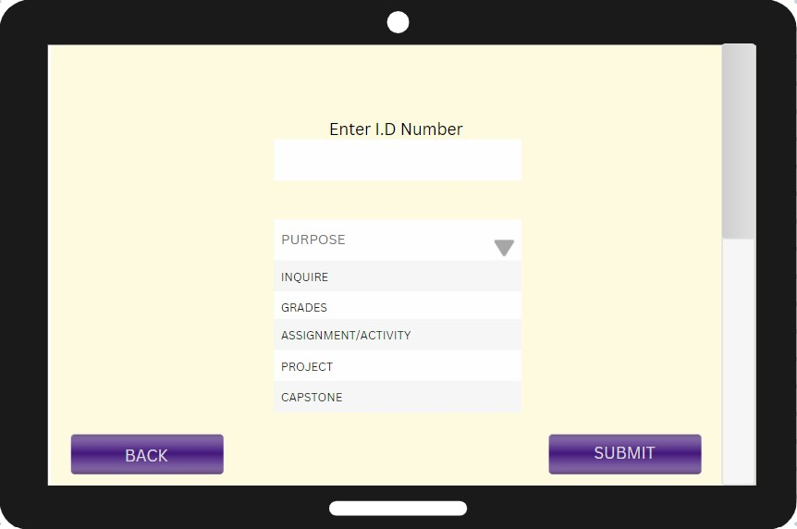
TOUCH PANEL
INDIVIDUAL

Slide 26
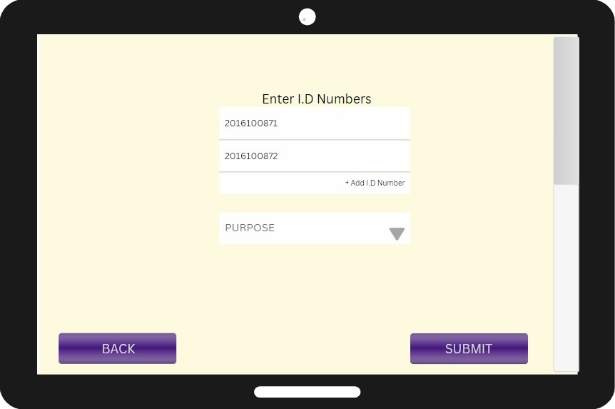
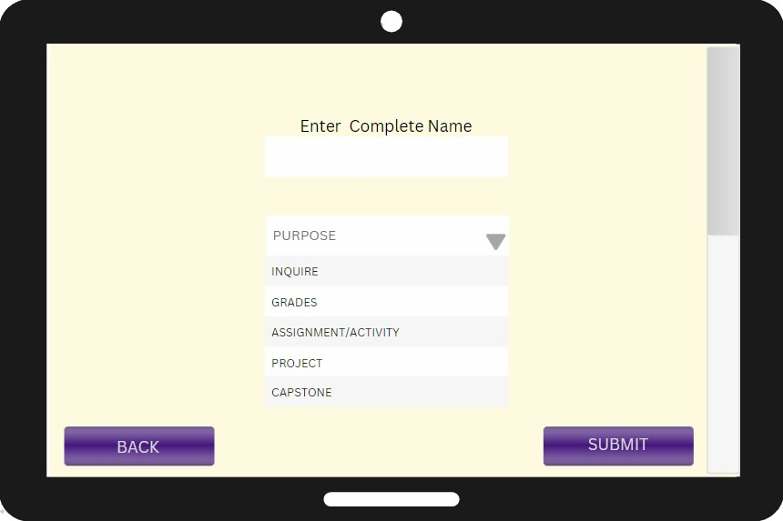
TOUCH PANEL
GROUP
GUEST

Slide 27
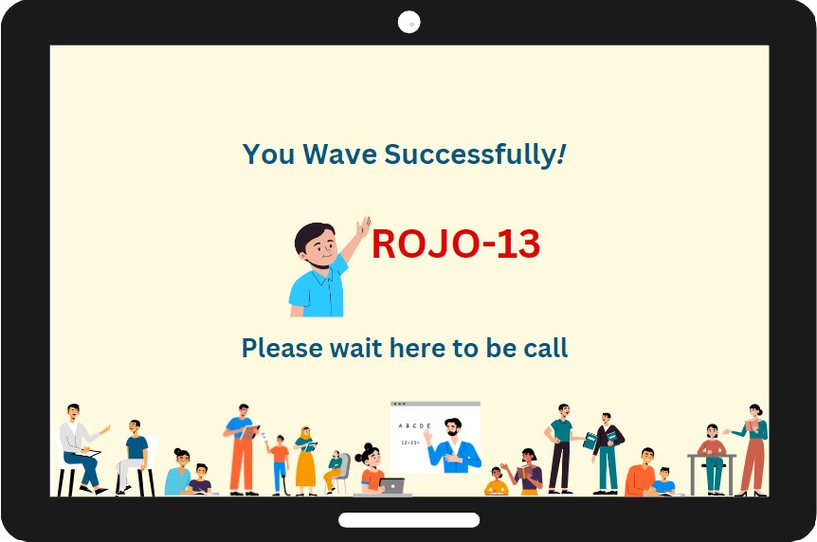
TOUCH PANEL

Slide 28
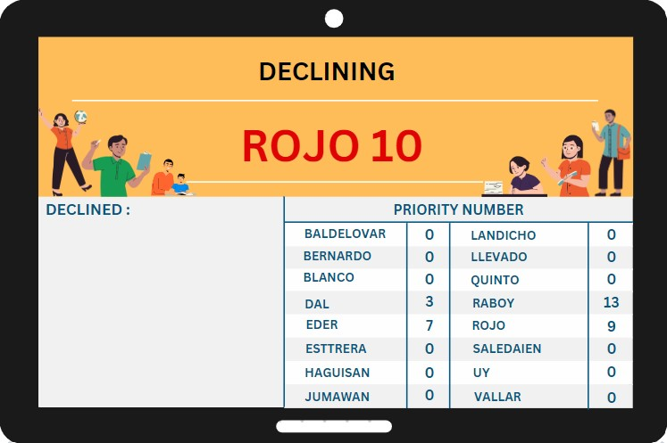
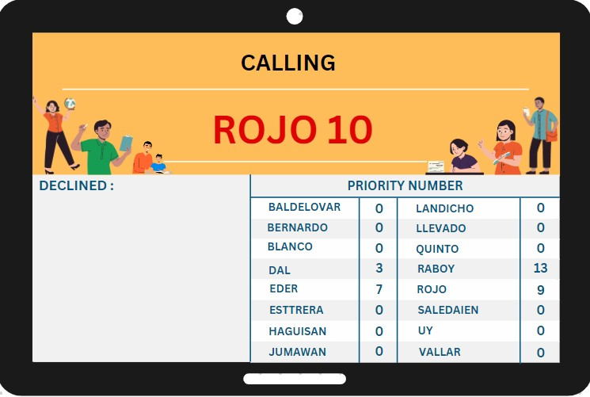
MONITOR

Slide 29
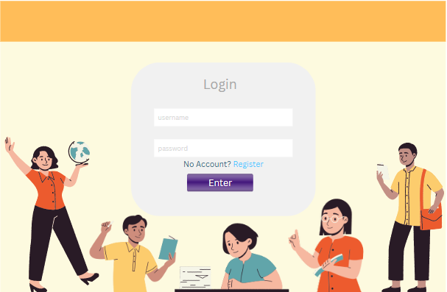
WEB APPLICATION
LOGIN

Slide 30
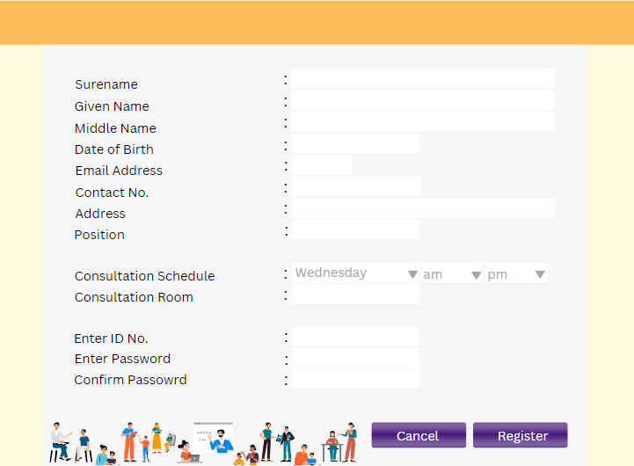
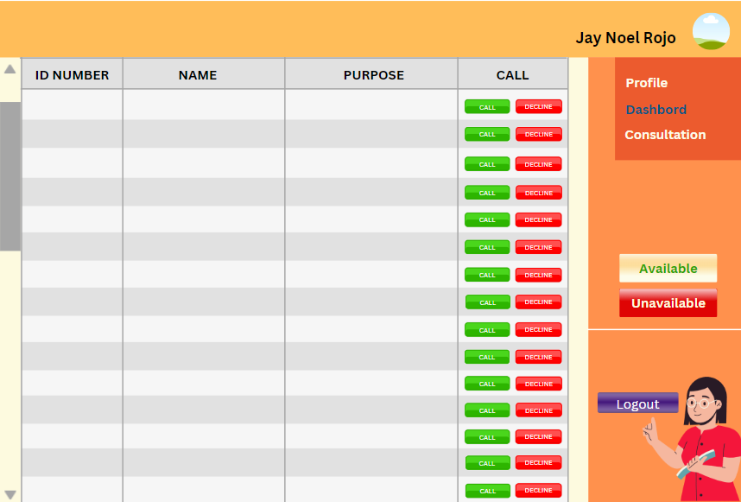
WEB APPLICATION
REGISTRATION
DASHBOARD

Slide 31
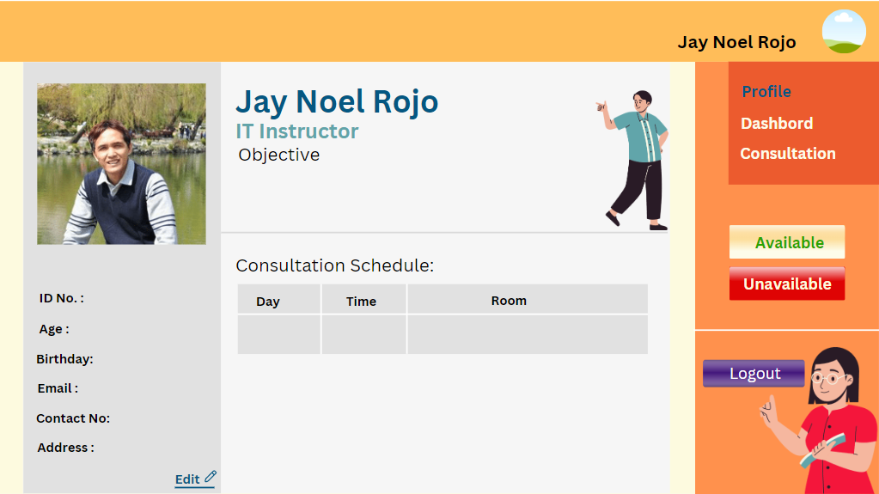
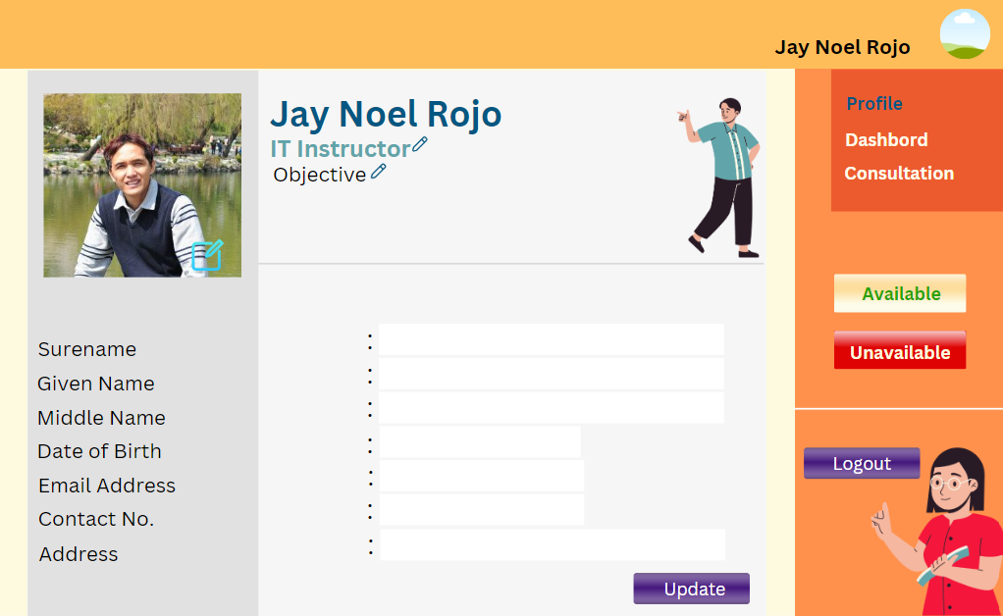
WEB APPLICATION
PROFILE
EDITING PERSONAL
DETAILS

Slide 32
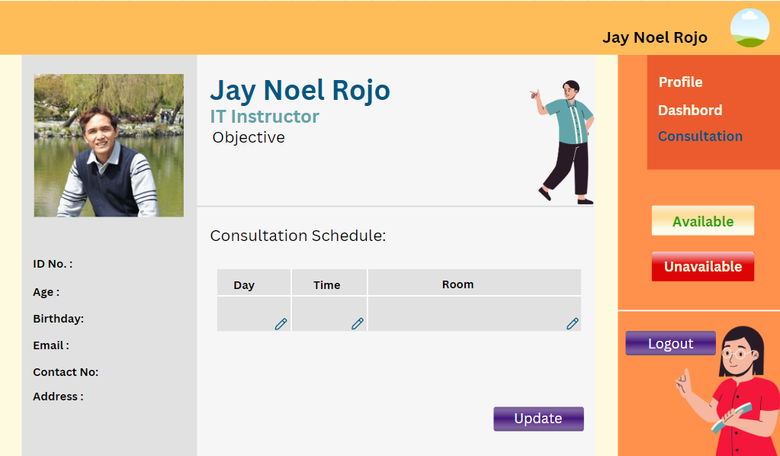
WEB APPLICATION
CONSULTATION

Slide 33
SOFTWARE AND HARDWARE NEEDED :
SOFTWARE
HARDWARE
Ktinter
Python Flask
MySQL
Touch screen panel
Raspberry Pi Model B 3
Computer
Monitor
Wires
UTP Cable

Slide 34
THANK YOU!

Slide 35
Editable Icons

